Slide 1

Data Analysing on Retail Dataset’s
YUVARAJA K,
NOVEMBER - 2025

Slide 2

INTRODUCTION
The Retail Sales Dataset's consists of a collection of transaction data that includes various attributes such as Transaction ID, Customer ID, Gender, Age, Product Category (Beauty, Clothing, Electronics), Quantity Sold, Price per Unit, Total Sales Amount, and the Date of Transaction.
This dataset's provides valuable information about customer purchase behavior across different product categories. By analyzing this data, insights can be gained into which product categories are most popular among different age groups — such as youngsters, adults, and elderly customers.
The analysis also helps to identify sales performance by gender, highlighting which products attract male and female customers the most. Furthermore, the dataset's supports the exploration of key areas where business performance can be improved, helping retail managers to strengthen marketing strategies, enhance customer engagement, and ultimately increase overall sales efficiency.

Slide 3
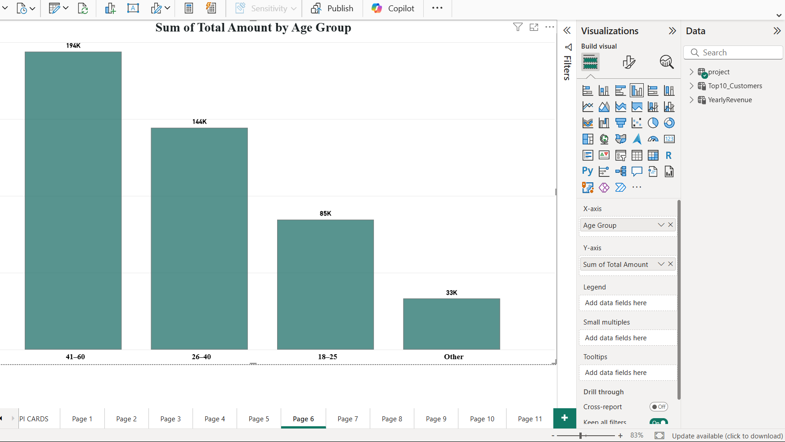
From Analysing the data using power bi we derived column chart by group wise

Slide 4
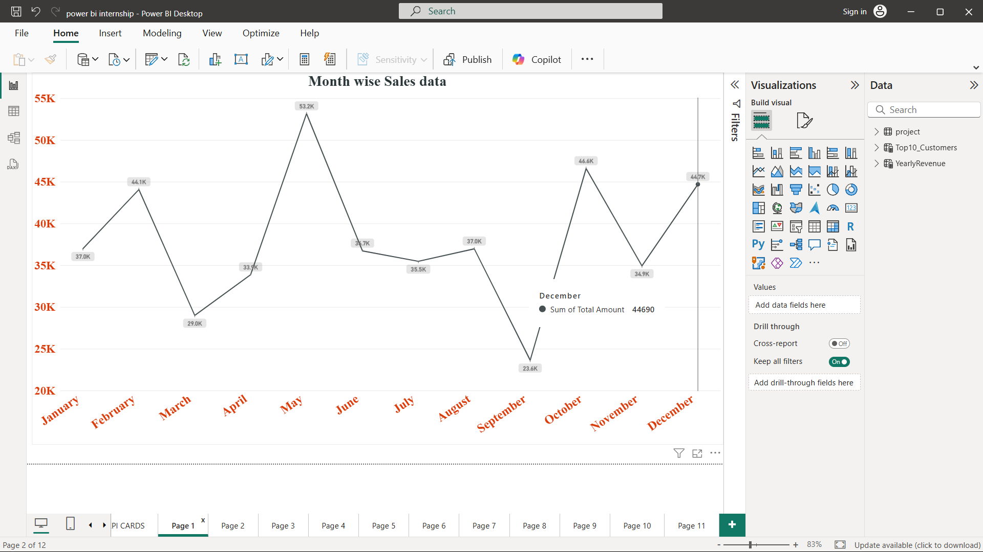
Month wise Total Sales has been analysed using the trend line chart.

Slide 5
OBSERVATION:
Based on the analysis of the date-wise sales report, it is observed that the maximum sales were achieved during May 2025, indicating a strong performance in that month. However, a significant drop in sales was noticed in September 2025, marking the lowest sales for the financial year.
This variation highlights a noticeable difference in monthly sales performance, which requires further investigation. The management team should analyze the possible factors contributing to this decline — such as seasonal demand changes, marketing activity, product availability, or customer interest — and take corrective actions.

Slide 6
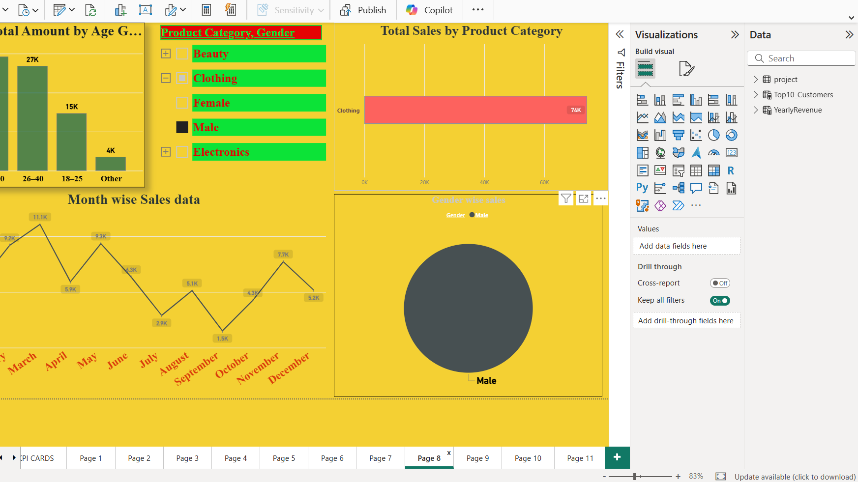
Visualizing Dashboards has been created to easily represents the real value of the datasets of retail sales

Slide 7
From the Dashboard
The above Donut Chart clearly represents the sales distribution of various product categories based on gender. From this analysis, a valuable observation can be made: Electronic products show high demand among male customers with total sales of ₹80,170, whereas female customers demonstrate strong interest in purchasing Clothing products, contributing to ₹81,275 in total sales.
However, sales of Beauty products among male customers are noticeably lower, indicating that this category does not attract much interest from the male segment. Therefore, it is recommended that the management and sales department focus on improving the quality, availability, and promotional strategies for Beauty products targeted at male customers to achieve more balanced sales across categories.
A similar pattern is also observed among female customers, where Beauty product sales are relatively lower compared to other categories. Hence, the management should pay special attention to enhancing product variety, maintaining quality standards, and adjusting pricing margins based on product quality. These improvements can help achieve higher and more uniform sales performance across all product categories.

Slide 8
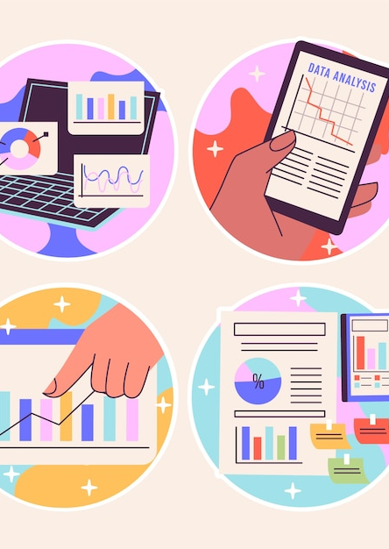
Conclusion:
Improve promotional strategies for underperforming product categories (especially Beauty).
Increase inventory and offers for high-demand categories like Clothing and Electronics.
Introduce targeted campaigns for specific age and gender segments.
Regularly monitor monthly sales to identify early signs of decline

